Slide 1


SECURE SOFTWARE DEVELOPMENT (SSD)
Diploma in CSF
Academic Year (AY) 20/21 – Semester 3 (April `20)
Week 3
Secure software requirements – Part 1
Last Updated: 02/04/2020

Slide 2
Contents
Remote Learning Instructions
Mission 3.3: Your First Razor Pages Application Reflections – Individual
Mission 3.1: HTTP vs HTTPS (Optional)
Recap Week 2
Quality Attributes of a Secure Software & Types of Software Security Requirements
Mission 3.2: Cryptographic Hash Functions (Optional)
Reflections - Individual

Slide 3
Remote Learning Instructions
Step 1
Read Recap Week 2 slide
Details in slide 4
Step 2
Read Quality Attribute of a Secure Software
Details in slide 5
Read Types of Security Requirements
Details Slide 6
Step 3
Attempt Open-Ended Question
More details in slide 9
Step 4
Do Mission 3.3 and submit in Teams
More details in slide 10

Slide 4
Recap Week 2
Research on the following concepts:-
Attacker vs Defender in cybersecurity
What is Confidentiality, Integrity & Availability (CIA)?
What is Authentication, Authorization, Auditing, Accountability?
Explain Non-Repudiation, Data Privacy, Data Anonymization, Personal Data Protection Act.
Read Week 2: Points in the research

Slide 5
Quality Attributes of a Secure Software
Qn: What makes a software secure?
Ans: A software is said to be secured when it is reliable (function as expected), resilient against attacks and readily recoverable when fails.
Reliability
The software functions as it is expected to.
Resiliency
The software does not violate any security policy and is able to withstand the actions of threat agents that are posed intentionally (attacks and exploits) or accidentally (user errors).
Recoverability
The software is able to restore operations to what the business expects by containing, limiting and remediating the damage caused by threats that materialize.

Slide 6
Types of Software Security Requirements
Qn: How to make a software secure?
Ans: For start, gather the necessary software security requirements.
Read Software Security Requirements

Slide 7
Mission 3.1: HTTP vs HTTPS (Optional)
Watch Sample - https://www.youtube.com/watch?v=91DwA5aFxLg
Use the Wireshark tool to demonstrate the difference between how HTTP and HTTPS protocols send and receive data on the Internet (Note: Wireshark is available in SSD VM image).
You may visit the below two websites to demo the differences. Sign in using any dummy userID.
http://alumnilifelong.nus.edu.sg/
https://alumnilifelong.nus.edu.sg/
Observe the difference in HTTP and HTTPS output of above links. Answer question below inside group “SSD-AY2021-xxx-Pxx-Txx → Week 3” in Teams
Describe which software security requirement does HTTPS protocol satisfies?
Please note that this is an optional mission.
Notes:
Tutor to brief students at the end of the activity

Slide 8
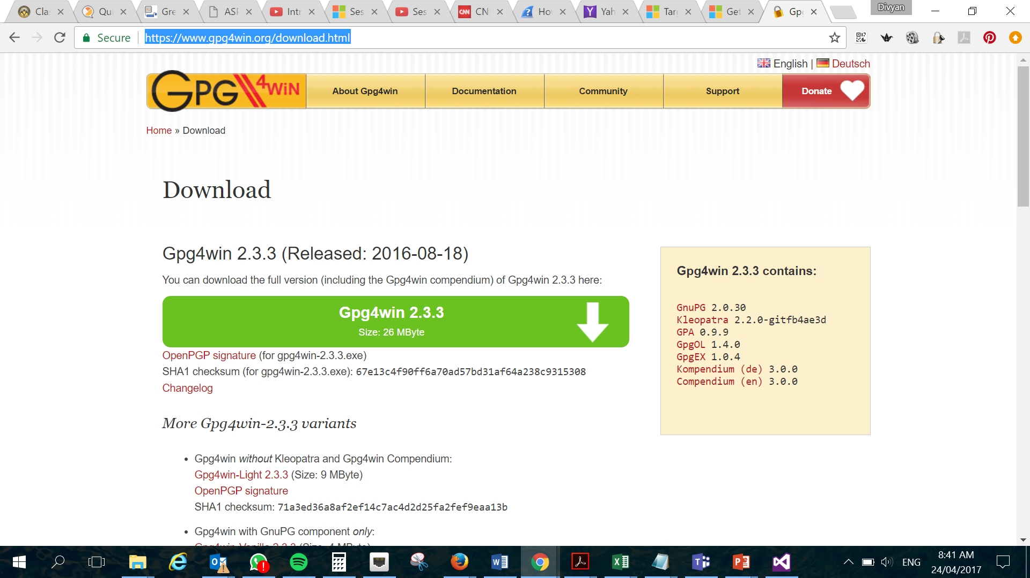
Mission 3.2: Cryptographic Hash Functions (Optional)
Visit https://www.gpg4win.org/download.html
Inside your “SSD-AY2021-xxx-Pxx-Txx → Week 3”
Create a Wiki/OneNote tab named “Mission 3.2”
Answer the followings:-
Why websites include checksums?
Describe the main characteristics of Cryptographic Hash Functions
How Cryptographic Hash Functions satisfy integrity requirements?
Please note that this is an optional mission.
Notes:
Tutor to brief students at the end of the activity

Slide 9
Open-Ended Question
Qn 1: Why is recoverability considered as one of the quality attributes of a secure software?
Go to Teams, create channel Week 3 (if not yet created)
In Week 3 channel, post question above in Teams in conversation, if not posted yet. (SSD module rep, please paste question, if not posted yet)
Answer question above in the Week 3 conversation. Do not create a separate conversation thread for the question.
Discuss/Comment on the answers given in the conversation thread .

Slide 10
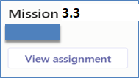
Mission 3.3: Your First Razor Pages Application (Individual)
Please note that Razor Pages mission (Week 1-3) is intentionally released early. The intent is to help you pace learning on Razor Pages.
Visit https://docs.microsoft.com/en-us/aspnet/core/tutorials/razor-pages/
Attempt the following topics:-
Create a Razor Pages web app
Add a model to a Razor Pages app in ASP.NET Core
Scaffolded Razor Pages in ASP.NET Core
Work with a database and ASP.NET Core
Update the generated pages in an ASP.NET Core app
Collate detailed screenshots of each of the completed topic in a word document and submit in Teams.
The screenshots must show the browser’s “Address Bar” to verify the application is running in your laptop.
Submit in General → Assignment (Mission 3.3 Razor Pages Intro)
Deadline: Submit at end of Week 3 (Penalty for late submission)
Note: Refer to document below for changing to NetCore 2.2 if you are using your own visual studio.

Slide 11
Mission 3.3: Your First Razor Pages Application (Individual) – Con’t
Please note that Razor Pages mission (Week 1-3) is intentionally released early. The intent is to help you pace learning on Razor Pages.
Visit https://docs.microsoft.com/en-us/aspnet/core/tutorials/razor-pages/
Attempt the following topics:-
Create a Razor Pages web app
Add a model to a Razor Pages app in ASP.NET Core
Scaffolded Razor Pages in ASP.NET Core
Work with a database and ASP.NET Core
Update the generated pages in an ASP.NET Core app
Guided Videos (Visual Studio 2017)
https://www.youtube.com/watch?v=F0SP7Ry4flQ
https://www.youtube.com/watch?v=sFVIsdR_RcM
https://www.youtube.com/watch?v=zxgKjPYnOMM
https://www.youtube.com/watch?v=A_5ff11sDHY
https://www.youtube.com/watch?v=yLnnleREMtQ
For Visual Studio 2019, refer to attached guide to create/start project in Visual Studio 2019. Once project created in 2019, you can follow steps as per guided worksheet.

